Slide 1
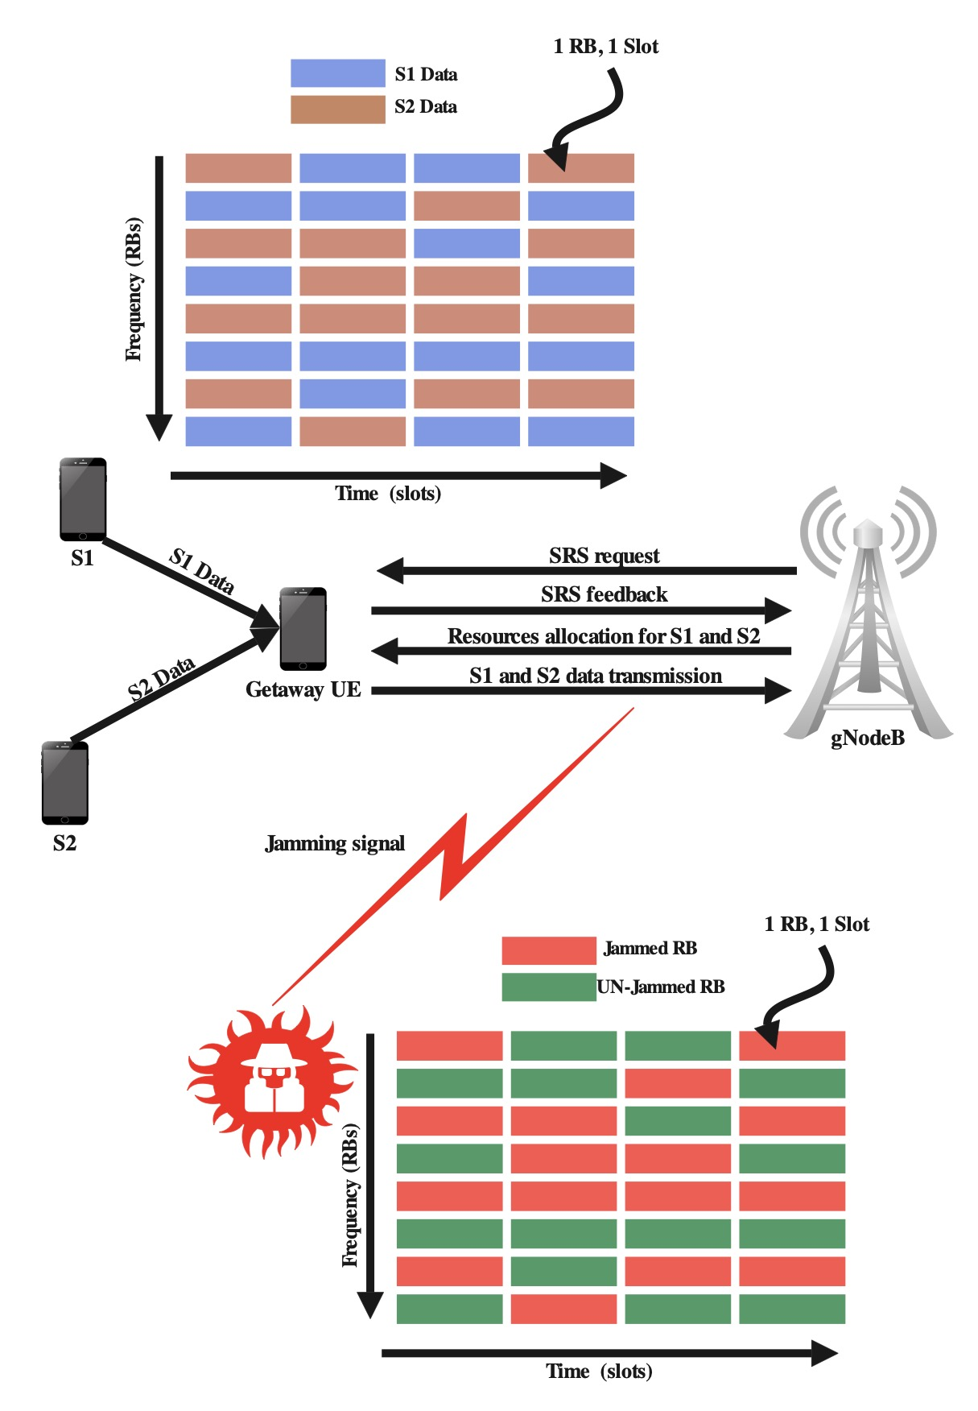


Task 2.1.c: Adaptive 5G Frequency Hopping
S1 : Source with high priority .
S2 : source with low priority .
SRS : sounding reference signal, used for channel quality measurement .
RB : resource block, the minimum frequency resource can be allocated to one user.
Slot : transmission time.
Jammer jams half of the frequency RBs, choose noncontiguous half of the number of available RBs to jams.
Jamming pattern change every time slot.
Channel measurement happens every time slot.
NSF’s Convergence Accelerator Curriculum
Phase 2

Slide 2
Task 2.1.c: Adaptive Frequency Hopping 5G Block Diagram
NSF’s Convergence Accelerator Curriculum
Phase 2

Slide 3
Task 2.1.c: Adaptive Frequency Hopping initial result (QPSK &16QAM, AWGN, No FEC)
MATLAB
code
MATLAB
5G
Toolbox
NSF’s Convergence Accelerator Curriculum
Phase 2

Slide 4
QUARTER 1: CONCLUSION
(Task 2.1.C: Adaptive 5G Frequency Hopping: Quarter 1)
Proposed 5G FH concept was verified successfully through analysis and 5G MATLAB simulation under additive white Gaussian noise (AWGN) and 50% partial-band Gaussian noise jamming (PBNJ) using QPSK & 16QAM with no forward error correction (FEC) coding.
Theoretical and simulated bit error rate (BER) versus SNR (i.e., Eb/N0) agree well.
Prioritized source in proposed 5G FH shows significant SNR gain (e.g., J/N dB) over the existing 5G scheduler w/o FH.
QUARTER 2: MILESTONE
Investigate BER of proposed 5G FH under AWGN, PBNJ, Rayleigh/Rician Fading with FEC.
Develop experiment and testing tools for proposed 5G FH via wireless communication medium.
NSF’s Convergence Accelerator Curriculum
Phase 2

